Slide 1
More Properties of Det
A is invertible
det(A) ≠ 0

Slide 2
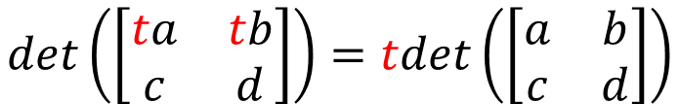
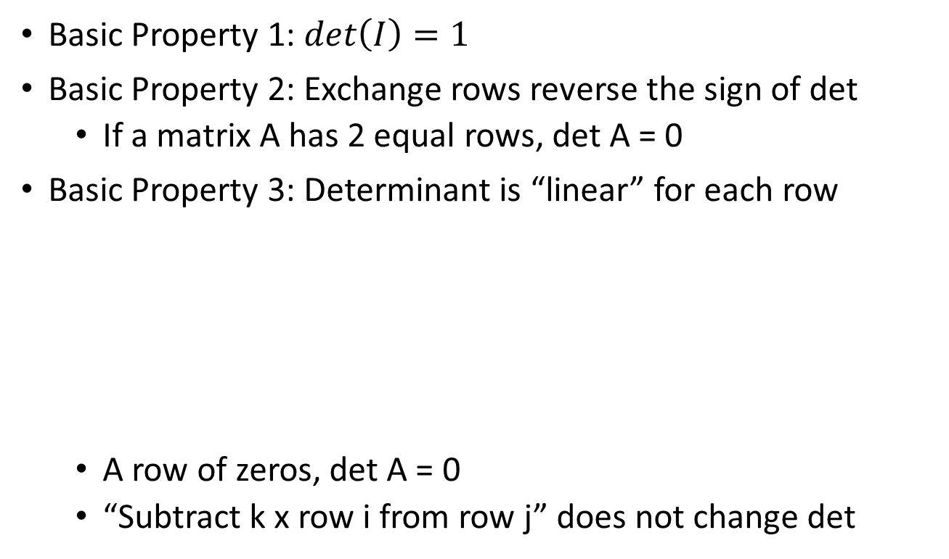
Properties of Determinants
Basic Property 1: $det\left(I\right)=1$
Basic Property 2: Exchange rows reverse the sign of det
If a matrix A has 2 equal rows, det A = 0
Basic Property 3: Determinant is “linear” for each row
A row of zeros, det A = 0
“Subtract k x row i from row j” does not change det
$$det\left(\left[\begin{matrix}ta & tb \\ c & d\end{matrix}\right]\right)=tdet\left(\left[\begin{matrix}a & b \\ c & d\end{matrix}\right]\right)$$
$$det\left(\left[\begin{matrix}a+a′ & b+b′ \\ c & d\end{matrix}\right]\right)=det\left(\left[\begin{matrix}a & b \\ c & d\end{matrix}\right]\right)+det\left(\left[\begin{matrix}a′ & b′ \\ c & d\end{matrix}\right]\right)$$

Slide 3

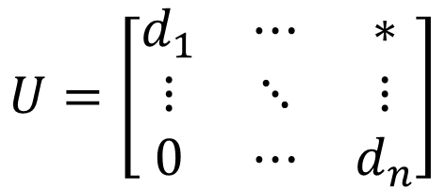
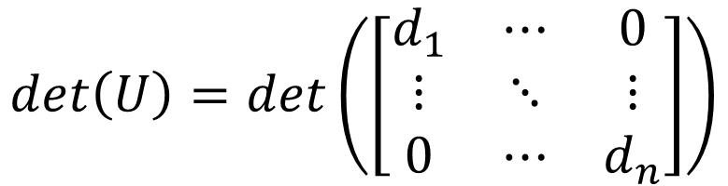
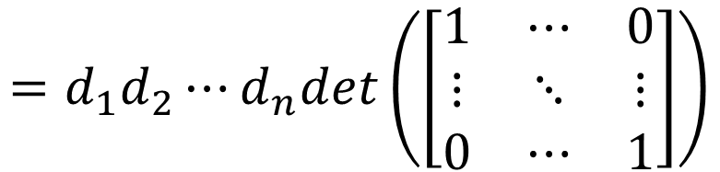
Determinants for Upper Triangular Matrix
$$U=\left[\begin{matrix}d_{1} & ⋯ & ∗ \\ ⋮ & ⋱ & ⋮ \\ 0 & ⋯ & d_{n}\end{matrix}\right]$$
Killing everything above
Does not change the det
$$det\left(U\right)=det\left(\left[\begin{matrix}d_{1} & ⋯ & 0 \\ ⋮ & ⋱ & ⋮ \\ 0 & ⋯ & d_{n}\end{matrix}\right]\right)$$
Property 1
$$=d_{1}d_{2}⋯d_{n}det\left(\left[\begin{matrix}1 & ⋯ & 0 \\ ⋮ & ⋱ & ⋮ \\ 0 & ⋯ & 1\end{matrix}\right]\right)$$
3-a
= 1
$$det\left(U\right)=d_{1}d_{2}⋯d_{n}$$
(Products of diagonal)

Slide 4
Determinant v.s. Invertible
A is invertible
det(A) ≠ 0
A
R
Elementary row operation
$$det\left(A\right)$$
$$det\left(R\right)$$
$$=±k_{1}k_{2}⋯det\left(A\right)$$
If A is invertible,
R is identity
Exchange:
Change sign
$$det\left(R\right)=1$$
$$det\left(A\right)≠0$$
Scaling:
Multiply k
If A is not invertible,
R has zero row
Add row:
nothing
$$det\left(A\right)=0$$
$$det\left(R\right)=0$$

Slide 5
Invertible
We collect one more properties for invertible!
Let A be an n x n matrix. A is invertible if and only if
The columns of A span R^{n}
For every b in R^{n}, the system Ax=b is consistent
The rank of A is n
The columns of A are linear independent
The only solution to Ax=0 is the zero vector
The nullity of A is zero
The reduced row echelon form of A is I_{n}
A is a product of elementary matrices
There exists an n x n matrix B such that BA = I_{n}
There exists an n x n matrix C such that AC = I_{n}
det(A) ≠ 0
onto
One-on-one
Notes:
When A is square, one side is sufficient.

Slide 6
Example
A is invertible
det(A) ≠ 0
$$A=\left[\begin{matrix}1 & −1 & 2 \\ −1 & 0 & c \\ 2 & 1 & 7\end{matrix}\right]$$
For what scalar c is the matrix not invertible?
det(A) = 0
$$detA=$$
$$1∙0∙7$$
$$+\left(−1\right)∙c∙2$$
$$+2∙\left(−1\right)∙1$$
$$−2∙0∙2$$
$$−\left(−1\right)∙\left(−1\right)∙7$$
$$−1∙c∙1$$
$$=0−2c−2−7−c$$
$$=−3c−9$$
not invertible
$$−3c−9=0$$
$$c=−3$$

Slide 7






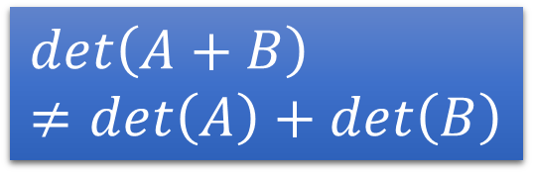
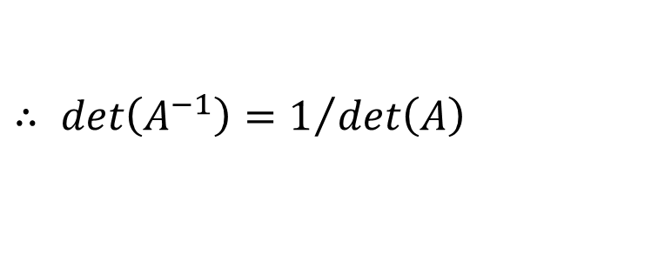


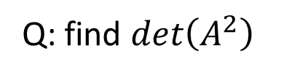
More Properties of Determinants
$$det\left(A+B\right)≠det\left(A\right)+det\left(B\right)$$
$det\left(AB\right)=det\left(A\right)det\left(B\right)$
$det\left(A^{T}\right)=det\left(A\right)$
Zero row → zero column
Same row → same column ……
Q: find $det\left(A^{−1}\right)$
$$∵A^{−1}A=I$$
$$=1$$
$$∴det\left(A^{−1}\right)det\left(A\right)=det\left(I\right)$$
$∴ det\left(A^{−1}\right)=1/{det\left(A\right)}$
Q: find $det\left(A^{2}\right)$
$$det\left(A^{2}\right)$$
$$=det\left(A\right)det\left(A\right)$$
$$={det\left(A\right)}^{2}$$
P212 - 215
Notes:
Column is “linear”

Slide 8

More Properties of Determinants
$det\left(AB\right)=det\left(A\right)det\left(B\right)$
Proof:
If A is not invertible:
A is not invertible
AB is not invertible
det AB = 0
A is not invertible
det A = 0
det A det B = 0

Slide 9

More Properties of Determinants
$det\left(AB\right)=det\left(A\right)det\left(B\right)$
Proof:
You have to proof that det EA = det E det A
If A is invertible:
$$A=E_{k}⋯E_{2}E_{1}$$
(E is elementary matrix)

Slide 10


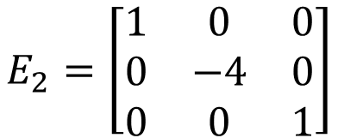


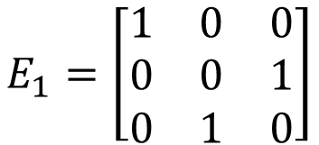




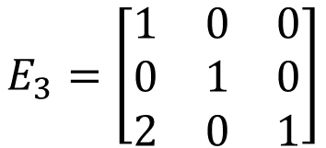

You have to proof that det EA = det E det A
Exchange the 2nd and 3rd rows
$$detE_{1}A=−detA$$
$$E_{1}=\left[\begin{matrix}1 & 0 & 0 \\ 0 & 0 & 1 \\ 0 & 1 & 0\end{matrix}\right]$$
$$=detE_{1}detA$$
$$detE_{1}=−1$$
Multiply the 2nd row by -4
$$detE_{2}A=−4detA$$
$$E_{2}=\left[\begin{matrix}1 & 0 & 0 \\ 0 & −4 & 0 \\ 0 & 0 & 1\end{matrix}\right]$$
$$=detE_{2}detA$$
$$detE_{2}=−4$$
Adding 2 times row 1 to row 3
$$detE_{3}A=detA$$
$$E_{3}=\left[\begin{matrix}1 & 0 & 0 \\ 0 & 1 & 0 \\ 2 & 0 & 1\end{matrix}\right]$$
$$=detE_{3}detA$$
$$detE_{3}=1$$

Slide 11




More Properties of Determinants
$det\left(AB\right)=det\left(A\right)det\left(B\right)$
Proof:
You have to proof that det EA = det E det A
If A is invertible:
$$A=E_{k}⋯E_{2}E_{1}$$
(E is elementary matrix)
$$det\left(A\right)=det\left(E_{k}\right)⋯det\left(E_{2}\right)det\left(E_{1}\right)$$
$$det\left(A\right)det\left(B\right)$$
$$=det\left(E_{k}\right)⋯det\left(E_{2}\right)det\left(E_{1}\right)det\left(B\right)$$
$$=det\left(E_{k}\right)⋯det\left(E_{2}\right)det\left(E_{1}B\right)$$
$$=det\left(E_{k}⋯E_{2}E_{1}B\right)$$
$$=det\left(AB\right)$$

Slide 12
More Properties of Determinants
det A = det A^{T}
Proof:
A is not invertible
det A = 0
=
A^{T} is not invertible
det A^{T} = 0
A is invertible
det E = det E^{T} …… in the textbook

Slide 13





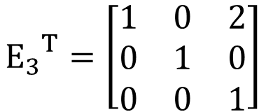
det E = det E^{T} …… in the textbook
Exchange the 2nd and 3rd rows
$$E_{1}=\left[\begin{matrix}1 & 0 & 0 \\ 0 & 0 & 1 \\ 0 & 1 & 0\end{matrix}\right]$$
$$={E_{1}}^{T}$$
$$detE_{1}=det{E_{1}}^{T}$$
Multiply the 2nd row by -4
$$E_{2}=\left[\begin{matrix}1 & 0 & 0 \\ 0 & −4 & 0 \\ 0 & 0 & 1\end{matrix}\right]$$
$$={E_{2}}^{T}$$
$$detE_{2}=det{E_{2}}^{T}$$
Adding 2 times row 1 to row 3
$$E_{3}=\left[\begin{matrix}1 & 0 & 0 \\ 0 & 1 & 0 \\ 2 & 0 & 1\end{matrix}\right]$$
$${E_{3}}^{T}=\left[\begin{matrix}1 & 0 & 2 \\ 0 & 1 & 0 \\ 0 & 0 & 1\end{matrix}\right]$$
$$detE_{3}=det{E_{3}}^{T}$$

Slide 14




More Properties of Determinants
det E = det E^{T} …… in the textbook
det A = det A^{T}
Proof:
$A$ is invertible
$$A=E_{k}⋯E_{2}E_{1}$$
$$det\left(A\right)=det\left(E_{k}\right)⋯det\left(E_{2}\right)det\left(E_{1}\right)$$
$$A^{T}={\left(E_{k}⋯E_{2}E_{1}\right)}^{T}$$
$$={E_{1}}^{T}{E_{2}}^{T}⋯{E_{k}}^{T}$$
$$det\left(A^{T}\right)=det\left({E_{1}}^{T}\right)det\left({E_{2}}^{T}\right)⋯det\left({E_{k}}^{T}\right)$$
$$=det\left(E_{1}\right)det\left(E_{2}\right)⋯det\left(E_{k}\right)$$

Slide 15



More Properties of Determinants
det E = det E^{T} …… in the textbook
det A = det A^{T}
Proof:
$$det\left(A\right)=sum of n! terms$$
Format of each term:
$$a_{1α}a_{2β}a_{3γ}⋯a_{nω}$$
Sorted by column indices
Find an element in each row
permutation of 1,2, …, n
Format of each term:
$$a_{α^{′}1}a_{β^{′}2}a_{γ^{′}3}⋯a_{ω^{′}n}$$
Find an element in each column
permutation of 1,2, …, n

Slide 16
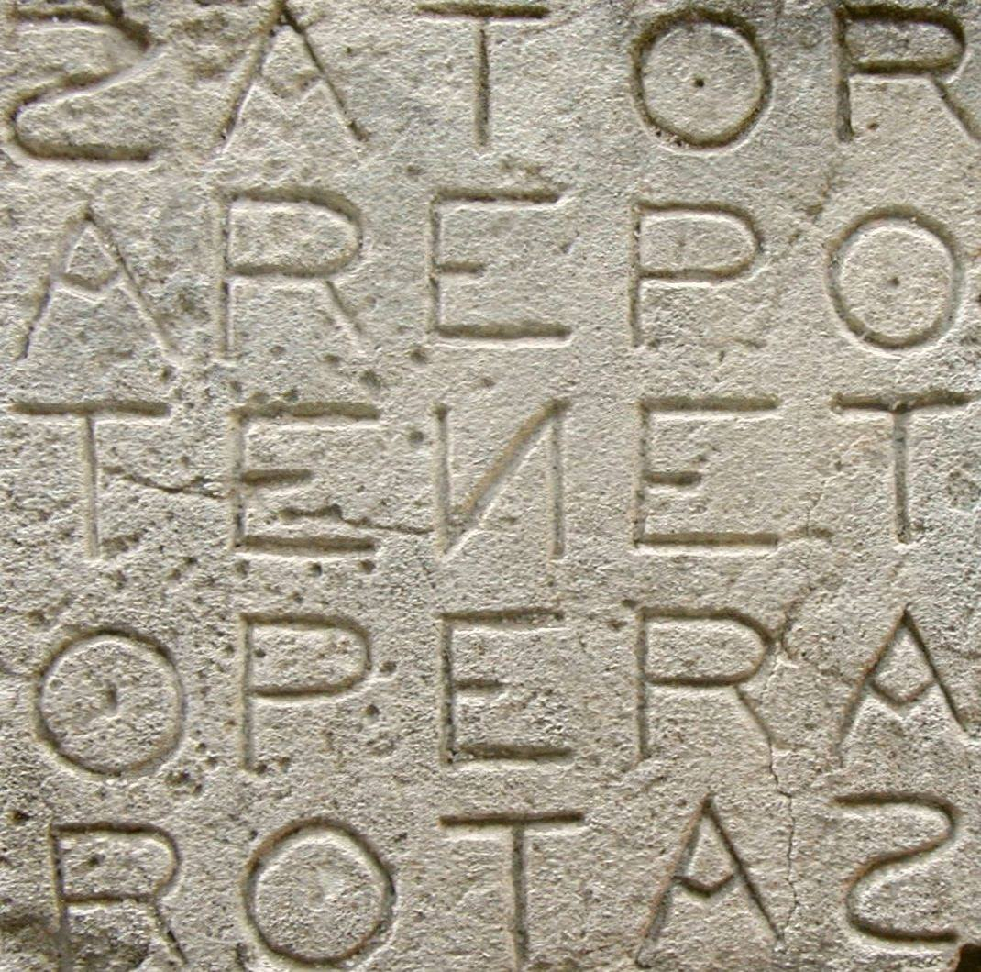
A v.s. A^{T}
Rank A = Rank A^{T}
det A = det A^{T}
Notes:
薩托爾魔方陣
目前最有名現存的「薩托魔方陣」文物是位於法國奧佩德 Oppède 刻在牆上的一個魔方陣，不論從上至下、從下至上、從左至右、從右至左，都能導出「SATOR」（播種者）、「AREPO」（源自埃及古字，意義不可考）、「TENET」（信條、宗旨、原則）、「OPERA」（Operation，運作）、「ROTAS」（輪子、球體、領域）這五個字，所以被相信這是向古羅馬的「農業之神」「播種者」薩圖恩 Saturn（土星 Saturn 和星期六 Saturday 都是以祂來命名）祈禱的咒文。
有趣的是，電影的開場正是在「歌劇院」Opera裡發生、肯尼斯布萊納所飾演的反派老大名字就叫做「薩托」Sator，ROTAS是片中物流公司的名稱、AREPO則是凱特疑似外遇的偽畫師名字，而「天能」Tenet則成為全片的核心主軸，一個不能違背的永恆「教條」。

